Slide 1
CGB1201 – JAVA PROGRAMMING PROJECT REVIEW-2
2
Department of Computer Science and Engineering
Academic Year: 2024 – 2025 (Odd Semester)
Register Number :2303811710421303
Name :JOTHIVEL.S
Year :II
Semester :III
Section :CSE-B
Date :23.11.24

Slide 2
TITLE OF THE PROJECT
Digital clock

Slide 3
ABSRACT
This project demonstrates the development of a console-based digital clock using Java, which dynamically displays the current time in real-time. The clock allows users to select between a 12-hour format with AM/PM indicators or a 24-hour format for time representation.
Utilizing the `LocalTime` class for fetching the system's current time and `DateTimeFormatter` for formatting, the program ensures precise and user-friendly time display.
A continuous update mechanism is implemented using a `while` loop with a one-second delay, achieved through the `Thread.sleep()` method.

Slide 4
Introduction
This project focuses on developing a console-based digital clock in Java that dynamically displays the current time in real-time. Users can choose between a 12-hour format with AM/PM or a 24-hour format. It leverages the LocalTime and DateTimeFormatter classes for accurate time retrieval and formatting. The clock updates every second using a while loop and Thread.sleep() method. This project highlights essential Java concepts, offering a simple yet practical application for learning real-time programming and user interaction.

Slide 5
Java Programming - Concepts Used
Date and Time API
Control Structures
Threading
User Input Handling
String Formatting
Dynamic Console Output

Slide 6
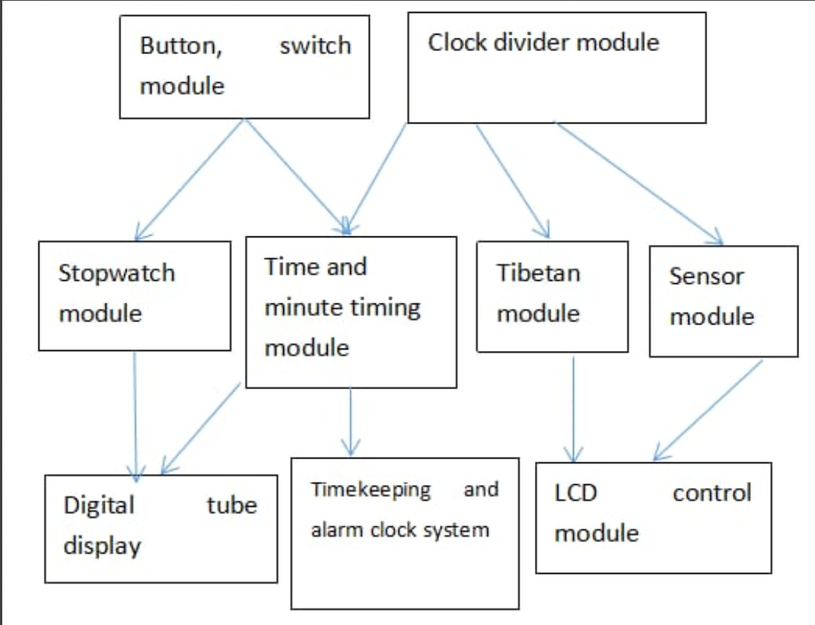
Proposed Architecture

Slide 7
MODULES DISCRIPTION
java.time Module
java.util Module
java.lang Module

Slide 8
Module Description
java.time Module:
LocalTime: Retrieves the current system time.
DateTimeFormatter: Formats the time in either 12-hour or 24-hour format for display.
java.util Module:
Scanner: Handles user input for selecting the preferred time format.

Slide 9
Module Description (Cont..)
java.lang Module:
Thread: Provides the sleep() method to introduce a one-second delay between updates.
System: Used for dynamic console output (System. out.print("\r")) and printing text.

Slide 10
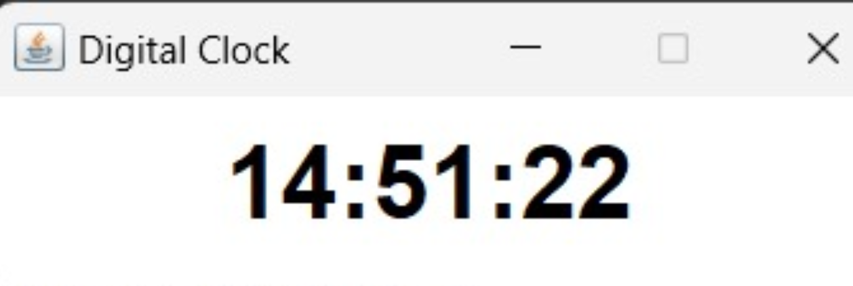
Results and Discussion

Slide 11
Conclusion
Conclusion:
The digital clock project successfully demonstrates a real-time, console-based application in Java. It allows users to view the current time in either 12-hour or 24-hour format, updating every second. By utilizing Java’s LocalTime, DateTimeFormatter, and threading, the program effectively handles time display and user input. This project highlights key programming concepts and serves as a solid foundation for more advanced applications, with potential for future enhancements such as a graphical user interface or additional features

Slide 12
Thank You

